Slide 1


Incentivization of Panchayats
( Revamped National Panchayat Awards -2022)
Testing URL: https://panchayataward.gov.in/demo/

Slide 2
Scope of Panchayat Awards
The Program emphasizes on scrutinizing and selecting the best performing Gram Panchayat and incentivize them.
Panchayat Award application will make this process transparent and efficient.
All Gram Panchayats will fill up questionnaires for all themes and submit to next level evaluation committee of those themes.
The committee for each theme will be constituted at :
        Block Level (BPPAC)
        District Level (DPPAC)
        State Level (SPPAC)
Each level of committee will evaluate and do Field verification and recommend top 3 Gram Panchayats to next level evaluation committee under all 9 thematic award.

Slide 3
Award Themes Incorporated
Gram Panchayats have to fill their nominations by answering all the 9 thematic questionnaire as mentioned below:
Poverty Free and Enhanced Livelihoods Panchayat
Healthy Panchayat
Child friendly Panchayat
Water Sufficient Panchayat
Clean and Green Panchayat
Self-Sufficient Infrastructure in Panchayat
Socially Secured Panchayat
Panchayat with Good Governance
Women-Friendly Panchayat

Slide 4
Create Type of Questions
  Facility for creating questions such as :
  Quantitative Type Question ( Radio button, Check box button, Grid type /Formula based)
  Well defined labels/answer options are made provisioned to answer the questions.
  Subjective Type Question , text area grid is provisioned to store panchayat’s response.
  Provision to declare any question as “Mandatory”
  Provision of File upload mandatory in some earmarked such questions.

Slide 5
Marking Scheme for each Question (Indicator)
  Each question is assigned maximum marks.
  Facility to store Marks for each answering options as per mapping in database
  Making scheme Indicator are used to calculate marks automatically based on the answer option selection by Panchayat
  Indicator is compulsory with each type of question
  For grid type questions, formula is prepared and stored for associated indicator.

Slide 6
Role wise Users : Process Flow
Center (Ministry)
Prepare Thematic questions,answer (Questionnaire) in consultation with Line Ministry
State /UT
Conduct Orientation to District Level & Monitoring GPs Nominations status
Work Flow frozen and Publish Questionnaire
SPPAC (Committee ) Assessment & Recommendation top 3 GPs (Each Theme) to Ministry
Award to top 3 GPs @State Level (Each Theme)
District Panchayat & Equivalent
Conduct Orientation to Block Level & Monitoring GPs Nominations status
DPPAC (Committee ) Assessment & Recommendation Top 3 GPS (Each Theme) to SPPAC
Award to top 3 GPs @District Level (Each Theme)
Block Panchayat & Equivalent
Assist GPs in filling nominations of all theme
BPPAC (Committee ) Assessment & Recommendation Top 3 GPS (Each Theme) to DPPAC
Award to top 3 GPs @Block Level (Each Theme)
Gram Panchayat & Equivalent
Filled Basic Details such as Sarpanch & Location Details,
Population & ER details, PFMS mapped Bank Account
Follow the general Instruction and submit their answer/nominations of all themes to BPPAC
Award to top 3 GPs @Block Level (Each Theme)

Slide 7
Prepare Questionnaire for each Thematic Award
Define Topic/Sub Topic
Define Question
Define Indicators
Create Questionnaire for each type of theme award .
Important :
Center ( Ministry) create questionnaire of all themes
State has to configure work flow ( BPPAC,DPPAC and SPPAC) , before publishing questionnaires

Slide 8
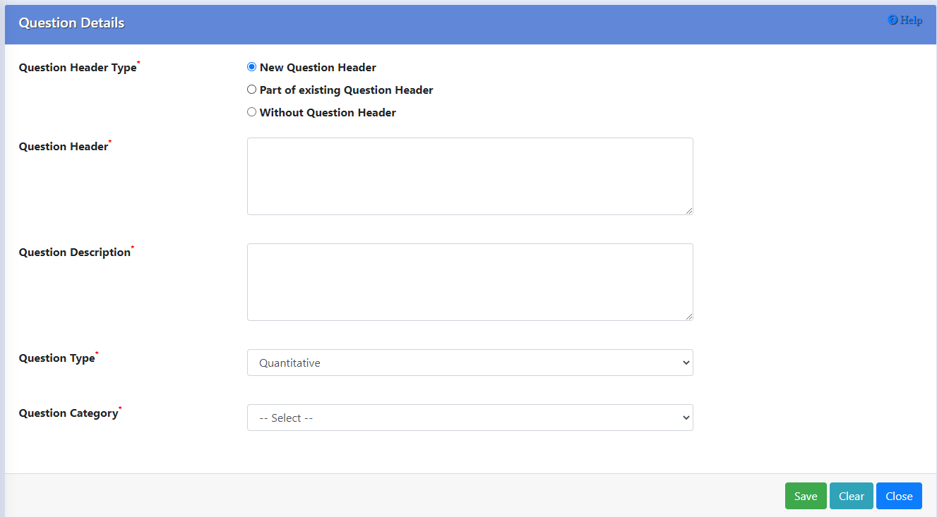
Prepare Type of Questions
Provision for Creation of Quantitative and Subjective Type of Questions
The specific Questions Headers/descriptions are recorded as per the question need.
Type of Questions ( Radio Option, Check Box, Grid Type formula based questions are selected and relevant Answer Marking Indicator can be choosen .

Slide 9
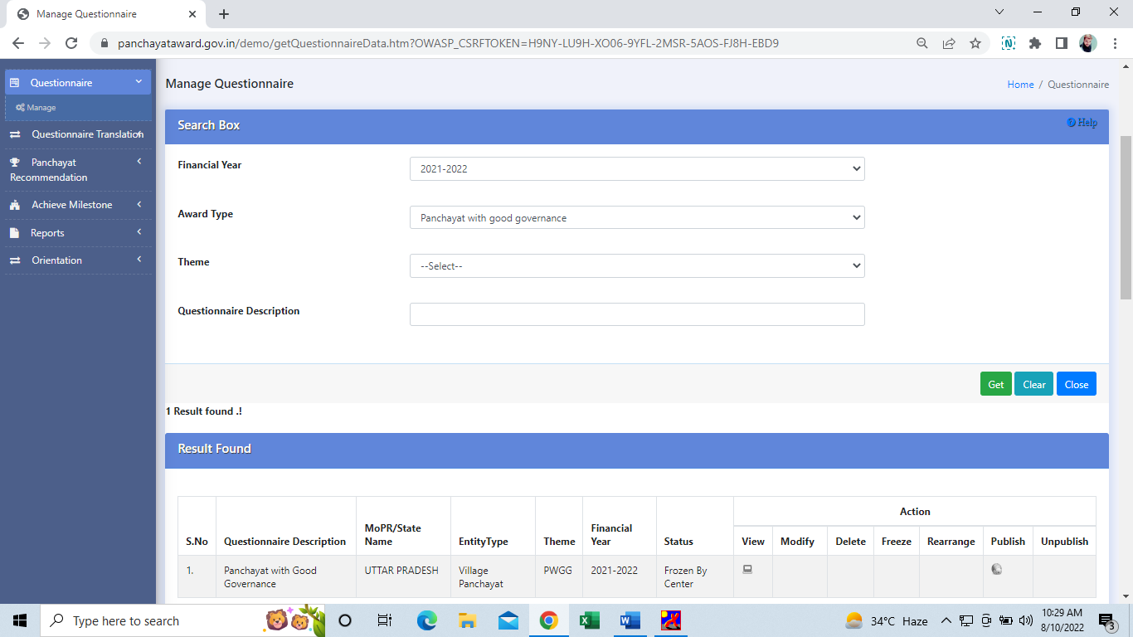
Manage Questionnaire
View Option available to view questions wise questionnaire prepared and frozen
Questionnaire can be Modify/Delete/Rearrange ( Questions) before frozen .

Slide 10
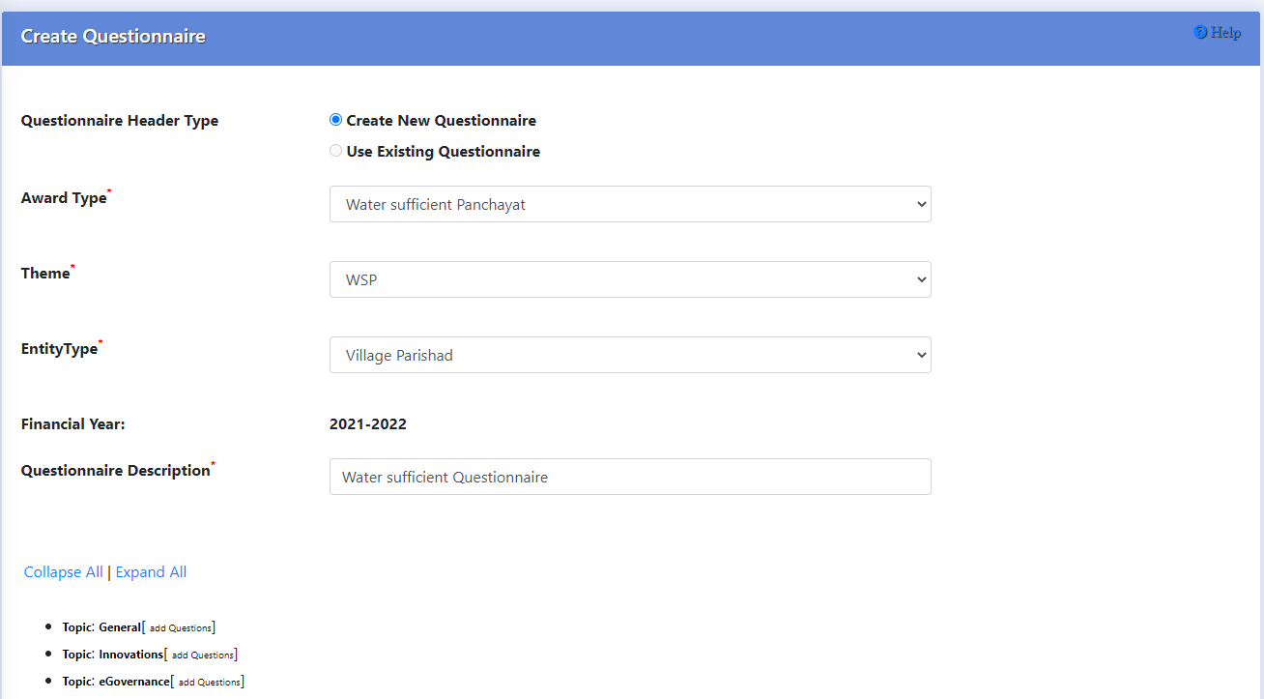
Create Questionnaire

Slide 11
State Admin Roles
Capturing Theme wise Orientation details
Configure Workflow of BPPAC/DPPAC/SPPAC
Publishing Questionnaire

Slide 12
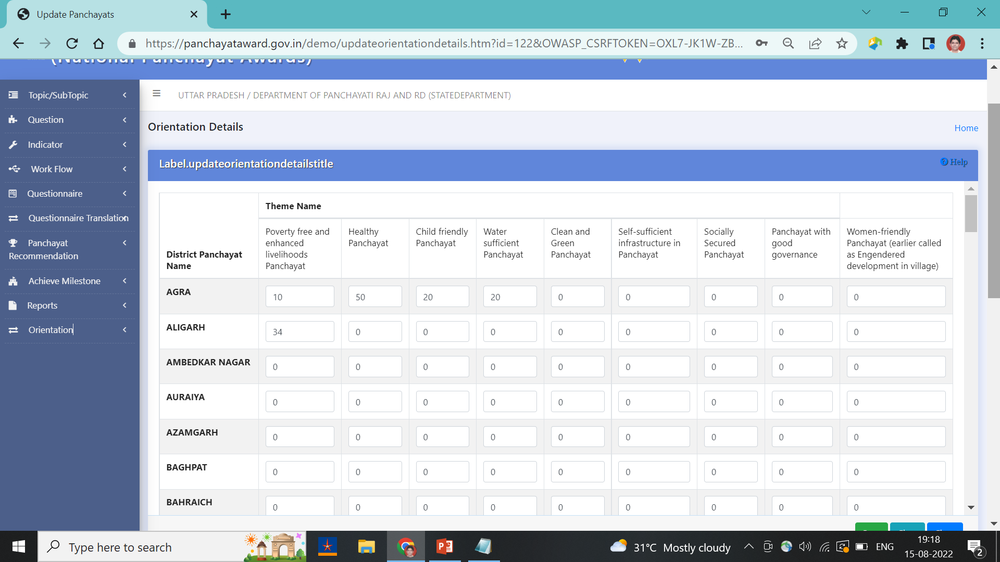
Capturing Orientation Details
Cascaded type training-cum-orientation programme is to be organized by state team and district team
Block Level officials will be master trainer and assist GPs in filling questionnaire correctly.
No. of officials trained for all themes are recorded in this format.

Slide 13
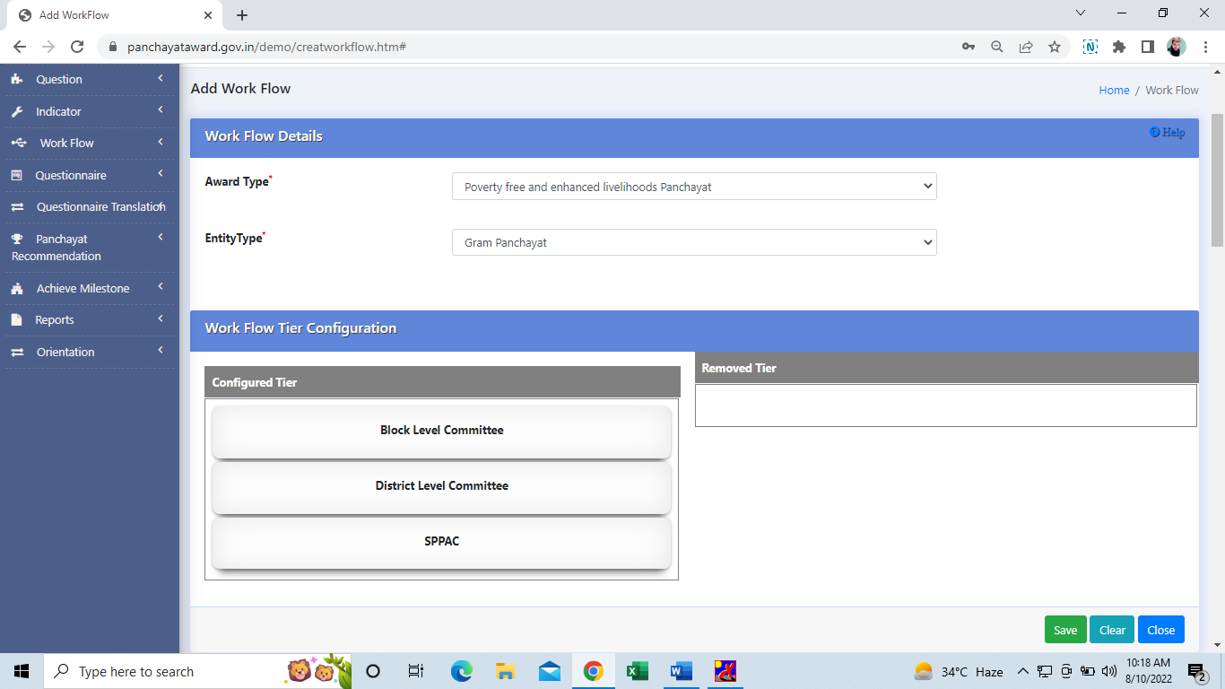
Work Flow Configuration for BPPAC/DPPAC/SPPAC
Note: This year work flow configuration functionality will not be enabled to states for editing, state, as it is mandatory for all states to do record assessment at BPPAC,DPPAC,SPPAC
State has to save the configured work flow as set by the Ministry

Slide 14
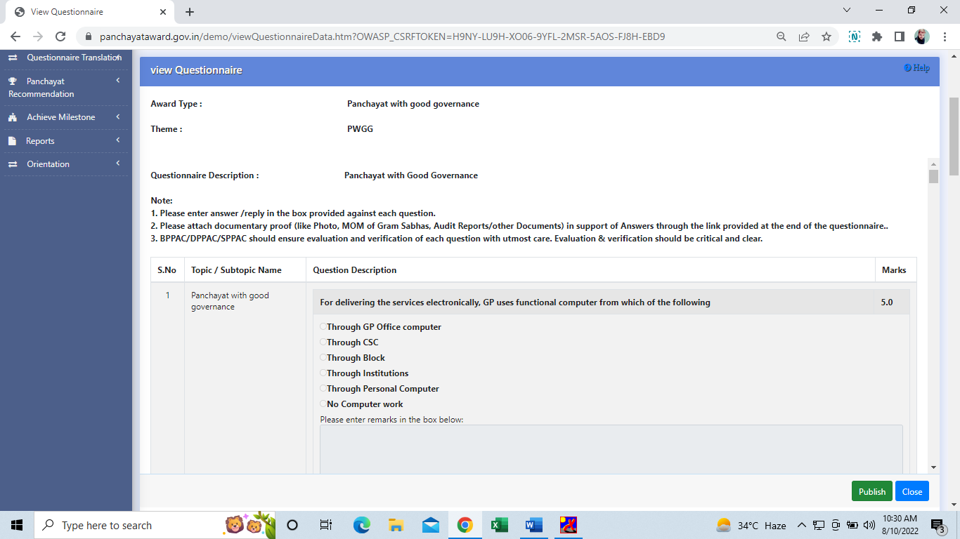
Publish Questionnaire
It will display the questions wise questionnaire prepared for each theme and its frozen
Once it is published then it is visible in GP user.

Slide 15
Gram Panchayat User
Basic Details entry for a Panchayat
Answer Questionnaire
Uploading attachment (Supporting documents)

Slide 16
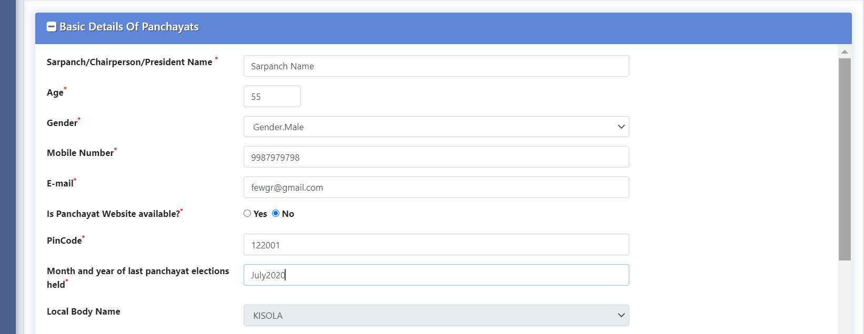
Basic Details of Gram Panchayat
Before start of answering any questionnaire, every gram panchayat has to enter and save the Basic Details
Basic Details → Add : To Record the basic details in the form. Such as Sarpanch details, Panchayat locations, No. of Households, No. of School, No. of Anganwadi, Populations details etc.
Basic Details → Manage :To Modify/Delete the already entered basic details

Slide 17
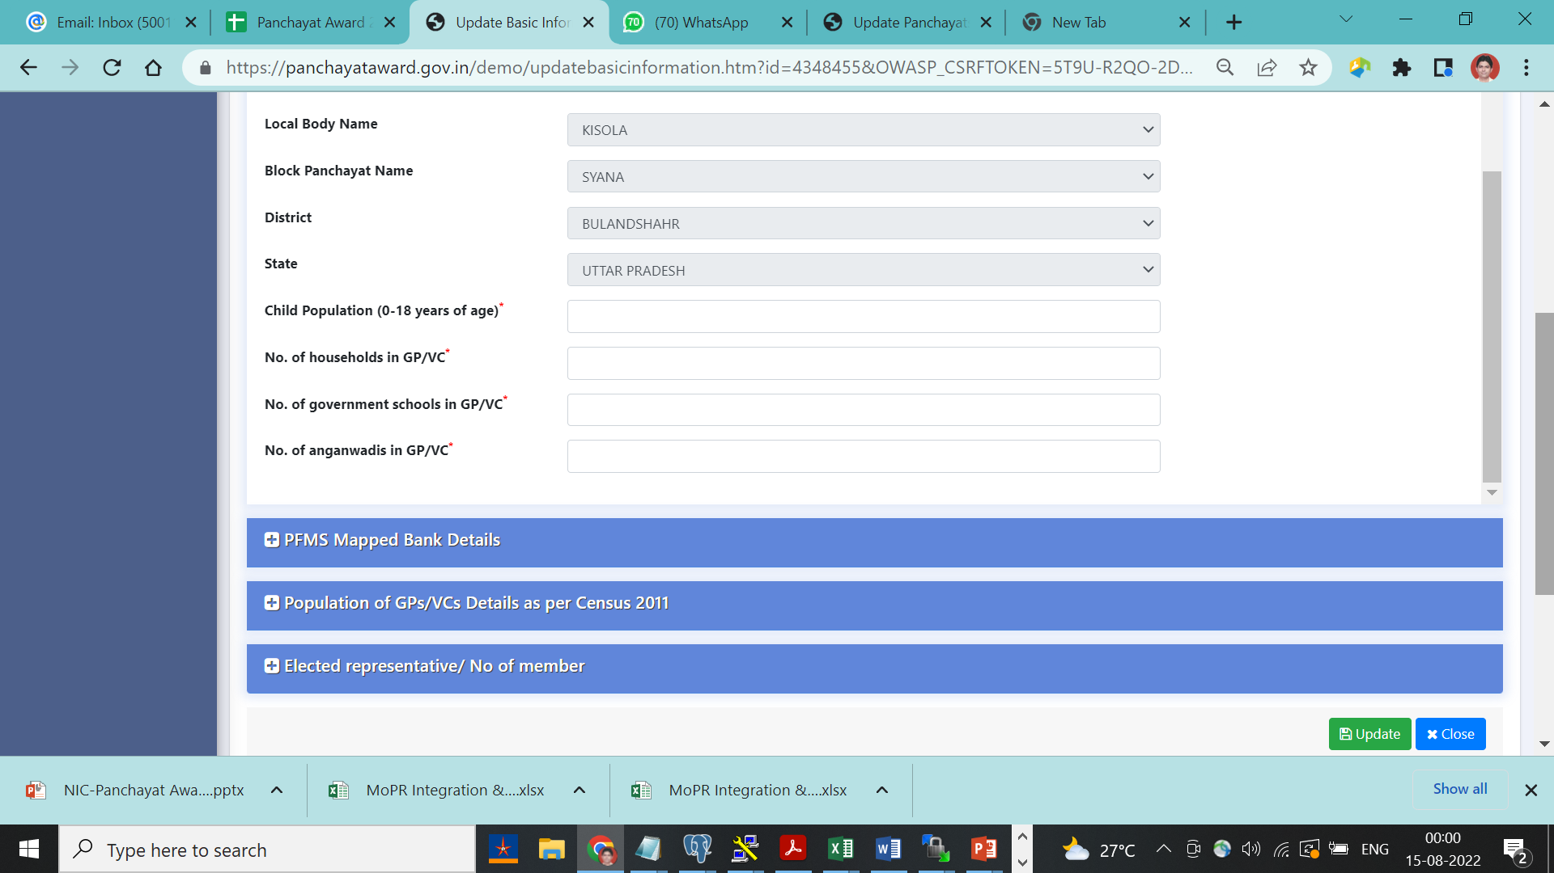
Basic Details of Gram Panchayat ..Cont.
Capture of Locations Details , No of Household, No of school, No of Anaganwadi Details of Gram Panchayat

Slide 18
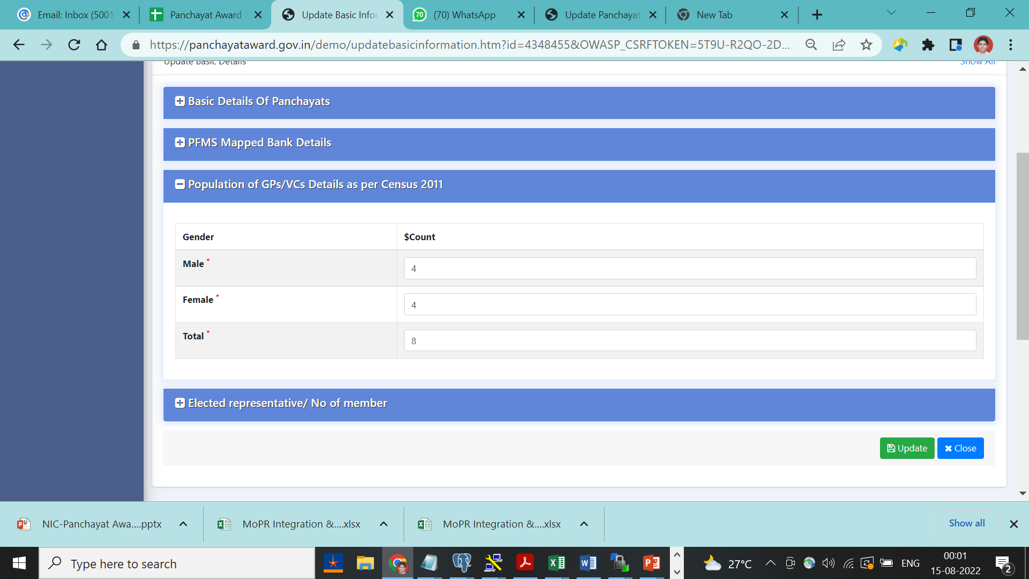
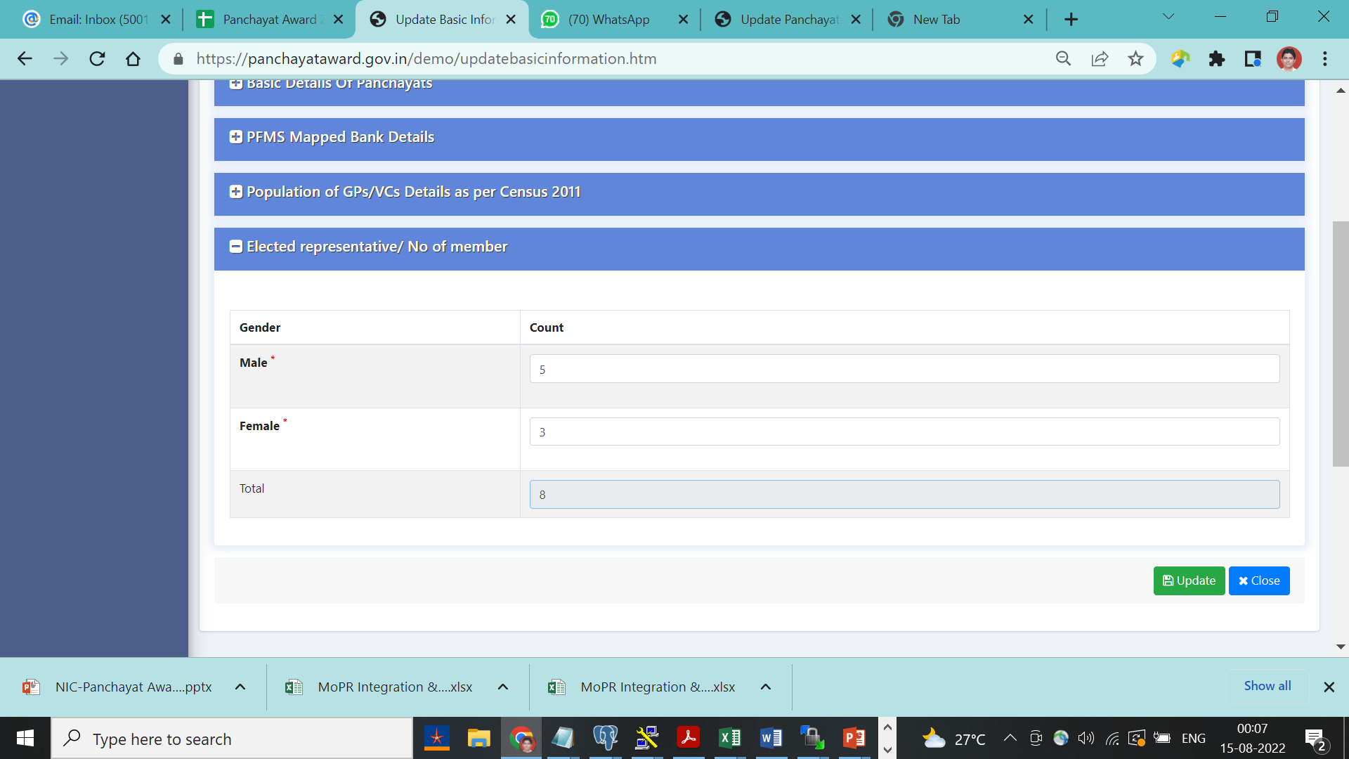
Basic details of Gram Panchayat ..Cont.
Capture of No of Male , Female in Populations and ER details

Slide 19
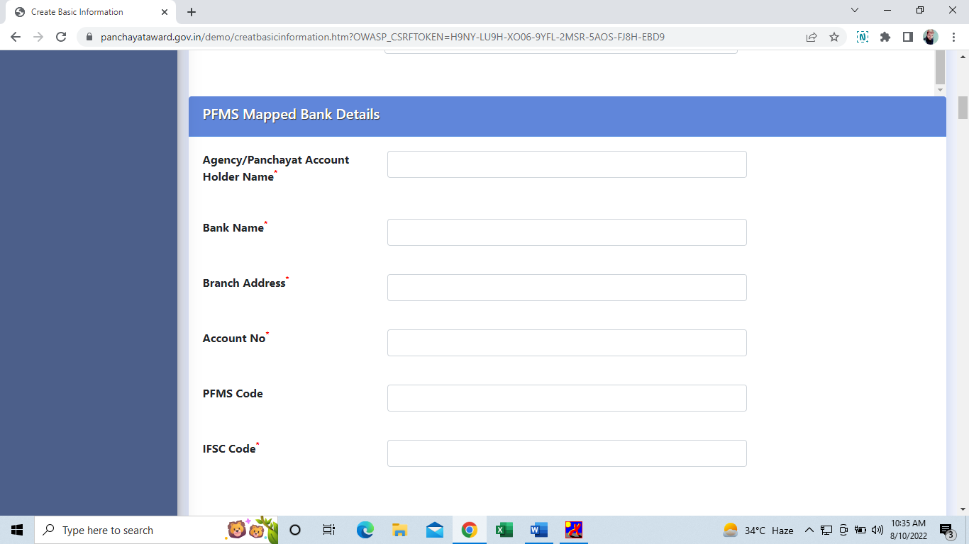
Capture PFMS Mapped Bank Details
Capture PFMS Mapped Bank Details for online transfer of awarded money in case of of awarded .

Slide 20
Answer Questionnaire : General Instructions
Before answering questionnaire, Panchayat has to read all general instructions carefully :
1.System will give ZERO marks against the non-attempting or wrongly attempt of any question .
2. In few question, File attachment in the form of pdf/jpeg is mandatory .
3. File upload size must be in specified range, special characters (*, %, @, !, & etc) are not allowed in file name and only one dot ‘.’ is allowed in the file name saving.
4. Scanning of documents in the form of file must be by reliable software ( Avoid pirated software source ), other wise due to security concern file will not be uploaded .
5. After submission of nomination, panchayat can download the answered questionnaire using manage option

Slide 21
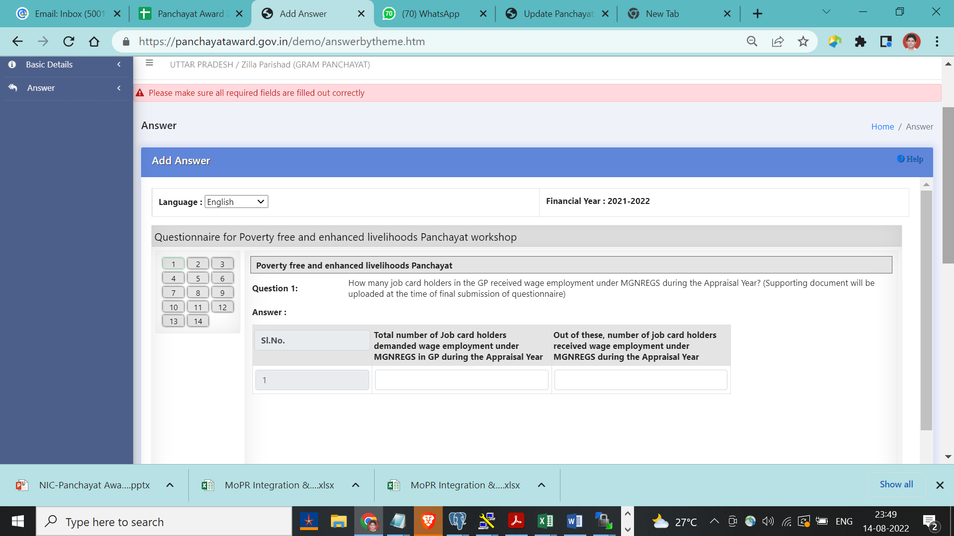
Answer Questionnaire ..Contd.
Answer Details → Add : To start answering questionnaire by selecting the desired thematic questionnaire.
One Question visible at a time with answer option . Next /Previous button can be used to move from one question to another OR can move directly to desired question by clicking on desired umber ( 1,2,3…..13,14) from left side grid.
Un-answered or wrongly answered question would be highlighted with Red color boundary and system will allocate ZERO Mark against such answers

Slide 22
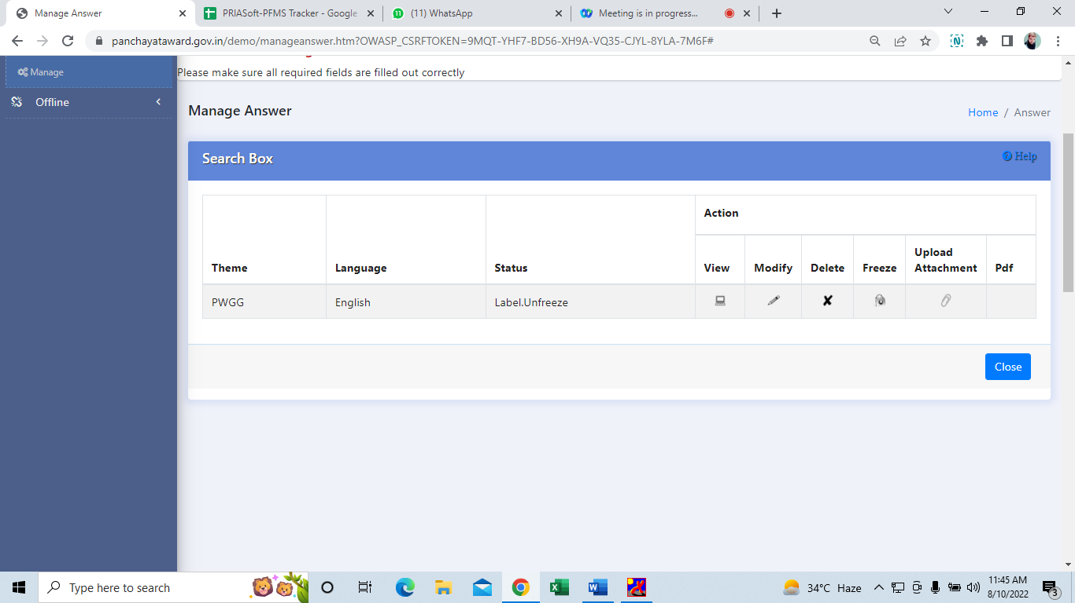
Manage Answer Details
This module may be used to VIEW, MODIFY and DELETE already answered questions ( Answer details ->Manage )
Upload Attachement : To Upload the scan file in PDF/JPG format
Click on PDF : Panchayat can download the answered questionnaire

Slide 23
Best Practices: For Maximum Nominations of Gram Panchayat
Cascaded level training-cum-orientation programme @District by State teams and @Block Level by District teams
Block Level trained resources will assist their Gram Panchayats in filling questionnaire.
Before filling Online questionnaire, GPs be advised to download the blank questionnaire, print it and fill up the answer details with pen. It will save time and minimize errors.
GPs should keep ready uploading files in PDF/JPG format using the genuine scanning tools.(Avoid pirated software tools due to cyber security concern).
GPs should save the questionnaire after filling one or two questions and later on other questions can be filled using the Manage→Modify.
Before final freezing questionnaire, GPs should verify correctness of saved answer details personally or can take help of Block level officials.
GPs should not wait till last cutoff date and should freeze their saved answer timely.( Especially bigger states’s GPs )
Monitoring cell @State,District and Block level should monitor GPs nominations status on regular basis for timely submission of maximum nominations.

Slide 24
BPPAC/DPPAC/SPPAC
Process Flow Details @BPPAC/DPPA/SPPAC
Capturing Committee Member detail
Thematic Committee Constituition (BPPAC/DPPAC/SPPAC)
Thematic Committee User Management
Thematic Committee Assessment & Field Verification
Recommednation of top 3 GPs for Award at each level

Slide 25
New Process Flow : Identifying & Recommend of
Top 3 Nos Panchayats @BPPAC/DPPAC/SPPAC
Top 3 no Panchayats are shortlisted by evaluation by thematic committee at Block, District and State.
Top 3 GPs as shortlisted ( @BPPAC level) are forwarded to DPPAC ( From each and every Block).
Assessment & Field Verification process followed at @DPPAC Level to shortlist 3 GPs per thematic award.
Top 3 GPs as shortlisted ( @All DPPAC) are forwarded to SPPAC ( From each and every District).
Assessment & Field Verification process followed at SPPAC to shortlist 3 GPs per thematic award.
Top 3 GPs as shortlisted at each state (SPPAC) are forwarded to Center (Ministry).
These Top 3 GPs are to be awarded at each Block , District and State
Only 3 best performing Gram panchayats will be awarded @Ministry level under each thematic award in the form of extra funds to enhance development in panchayats.
Note: This year, the recommendation of fixed no. of Panchayats for award, will NOT be provisioned.

Slide 26
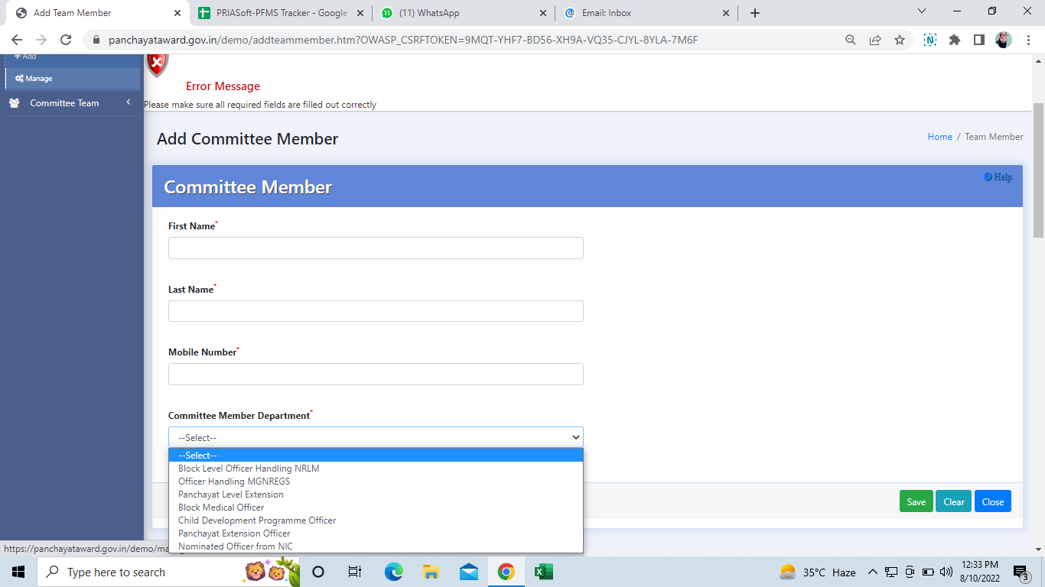
Capture Thematic Committee Member @BPPAS/DPPAS/SPPAS
Initially capture the committee members details such as name, department name, mobile number etc.,
Respective thematic committee are formed at each Gram Panchayat using the committee member.

Slide 27
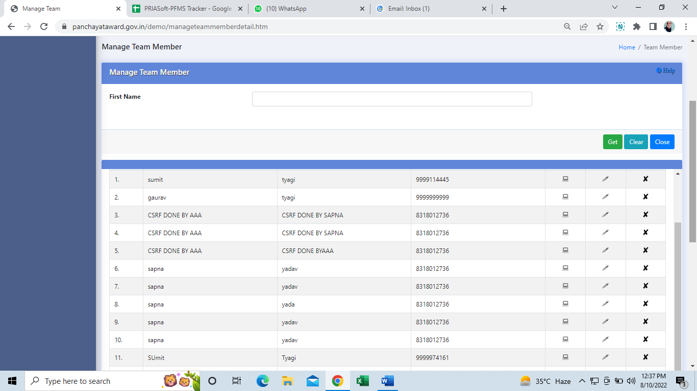
Thematic Committee Member Management @BPPAC,DPPAC,SPPAC
Provision is given to VIEW, MODIFY and DELETE the details of already entered thematic Committee member

Slide 28
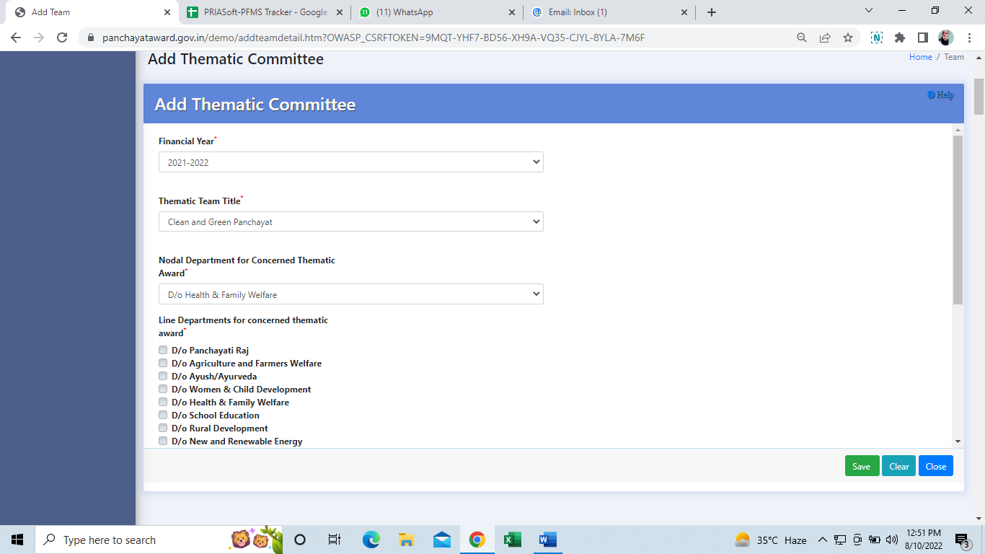
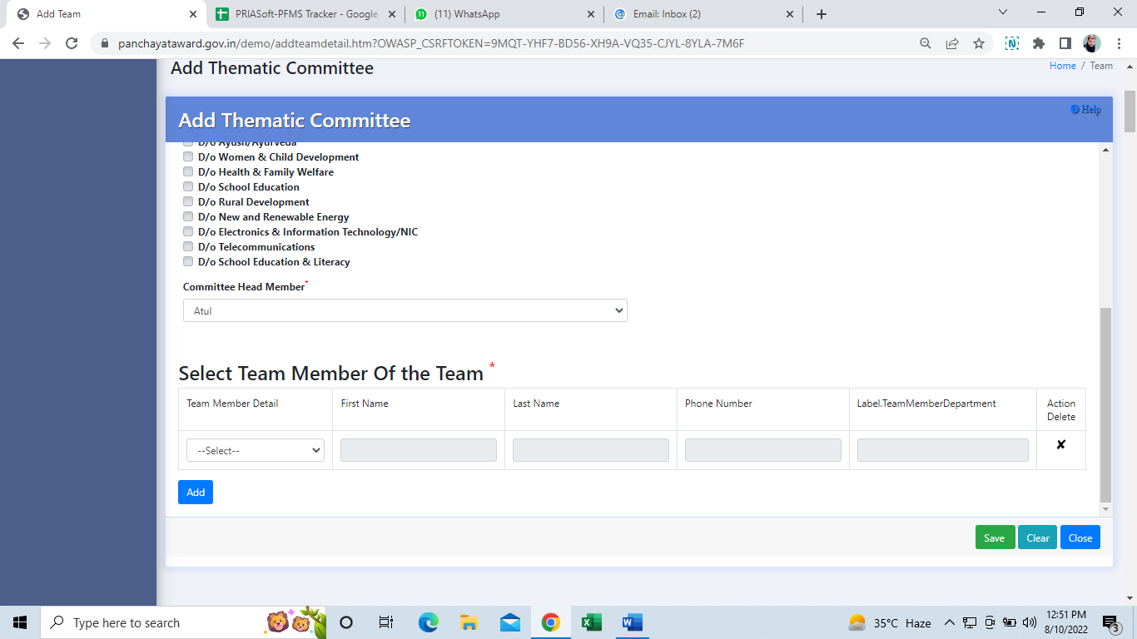
Thematic Committee Constitution @BPPAC,DPPAC,SPPAC
The committee members will be selected to constitute theme based committee teams.
Minimum 2 members are must to constitute a committee team.

Slide 29
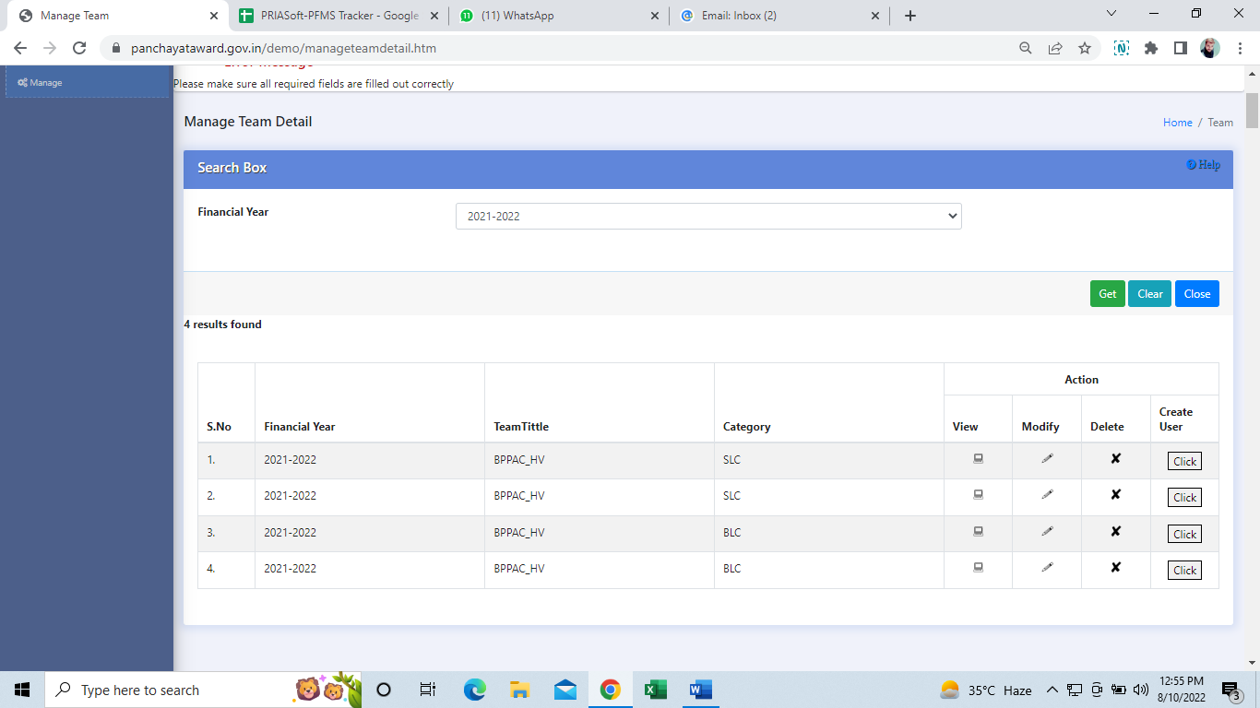
Thematic Committee User Creation
Provision given to create the individual users for each thematic committee .
In Manage form → Click button just below Create User option against all respective created committee shown in a grid.

Slide 30
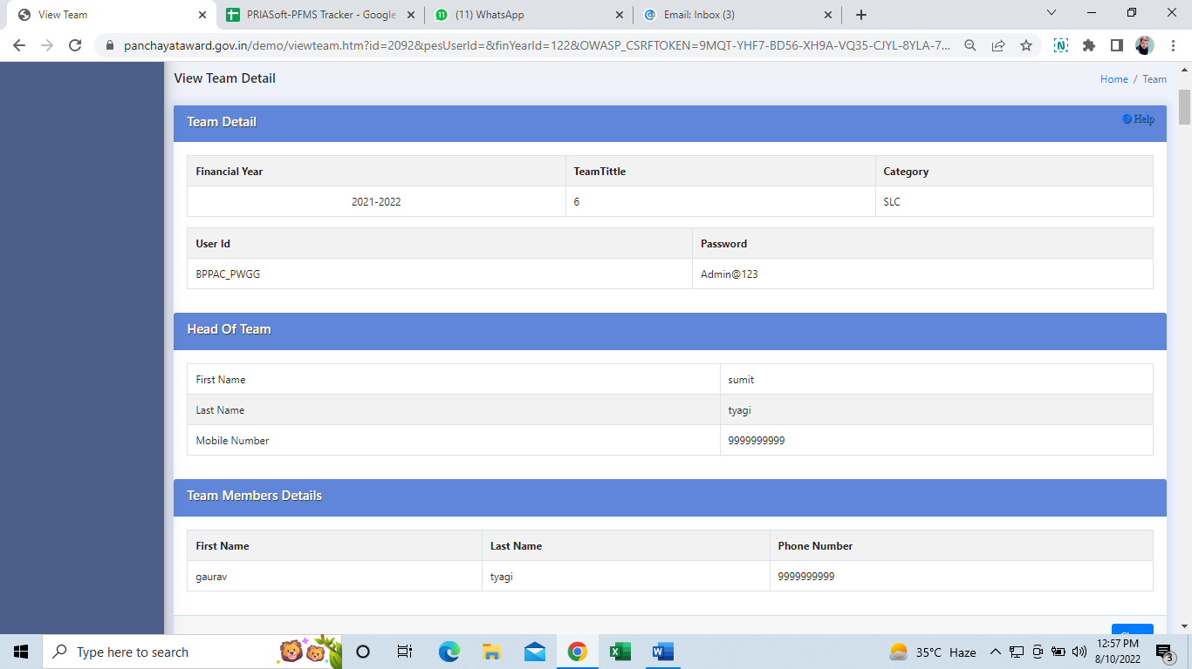
Thematic Committee User Management
In View Team Detail : User created for the committee will display the User-id related details

Slide 31
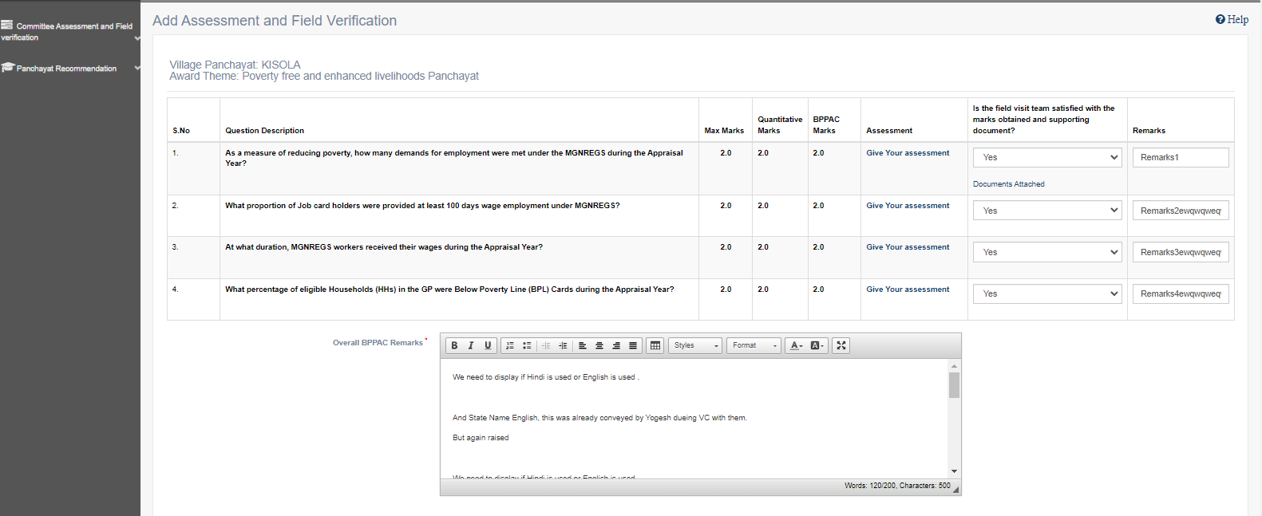
Thematic Committee Assessment & Field Verification
Assessment & Field Verification of Gram Panchayats nomination will be undertaken by respective Thematic Committee users @ (BPPAC/DPPAC/SPPAC level .
Committee should analyze each and every answer to any question and mark appropriate answer selections.

Slide 32
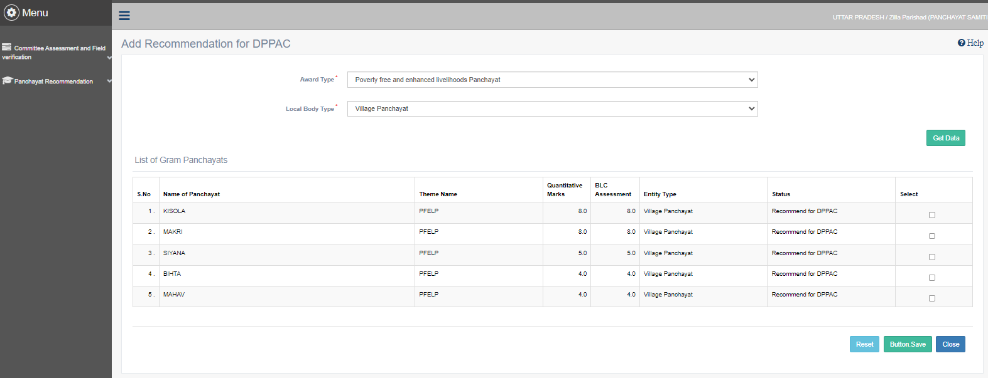
Thematic Committee Assessment & Field Verification …Contd.
Top 3 ranked Gram Panchayats will be recommended to higher committee (BPPAC → DPPAC, DPPAC → SPPAC)

Slide 33
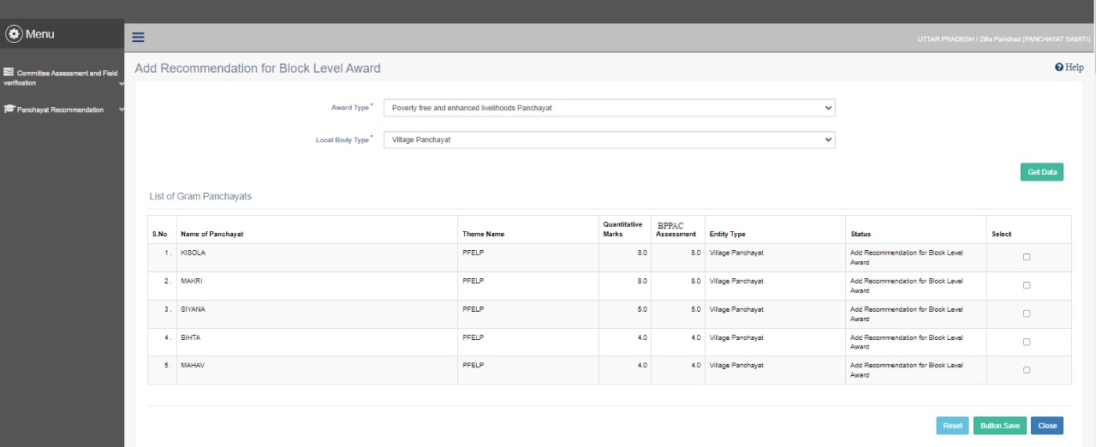
Recommendation of Top 3 GPs for award @BPPAC,DPPAC,SPPAC
Top 3 Rank shortlisted Gram Panchayats at each @BPPAC level will be awarded at Block Level.
Further Top 3 Rank shortlisted Gram Panchayats at each @DPPAC level will be awarded at District level.
Further Top 3 Rank shortlisted Gram Panchayats at each @SPPAC level will be awarded at State level

Slide 34
REPORTS

Slide 35
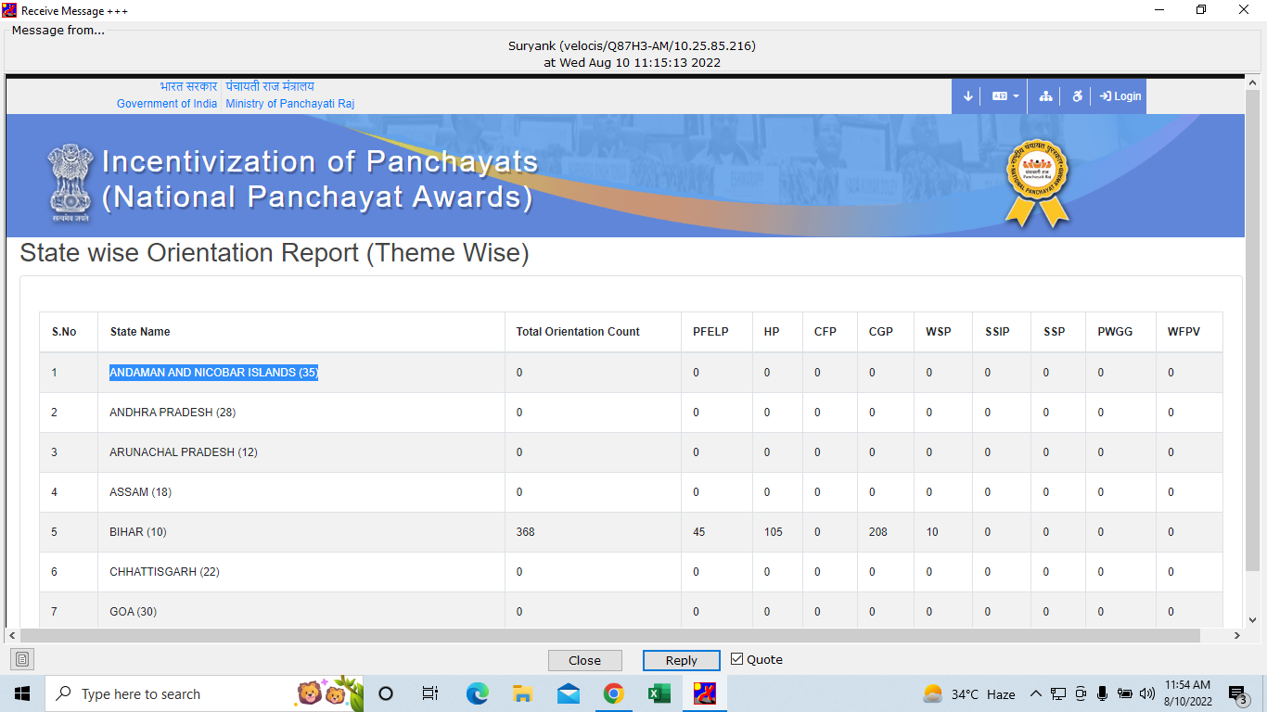
Orientation Report
This report is facilitated to display No of resources trained @District and Block Level resources on theme wise filling of online questionnaire.
Action Plan will be finalized for timely conducting of orientation programme.

Slide 36
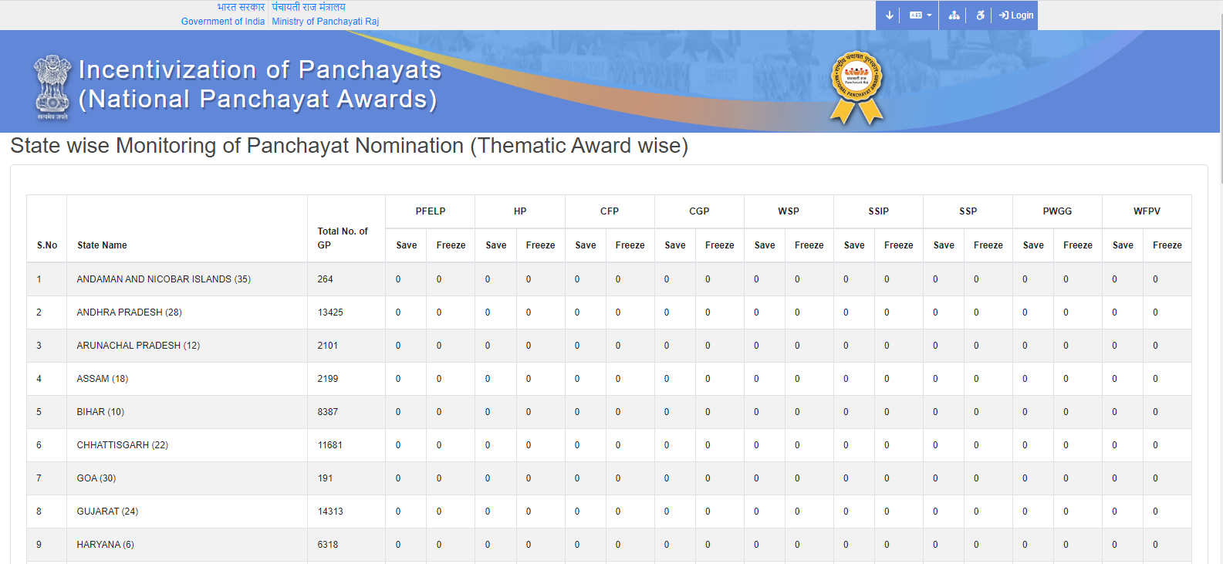
Monitoring Report : Theme wise Panchayat Answer Nominations@State& District Level
State & District can monitor the No. of GPs Nomination in Save and Frozen stages.
They can push the GPs for timely freezing the nominations before the cutoff date

Slide 37
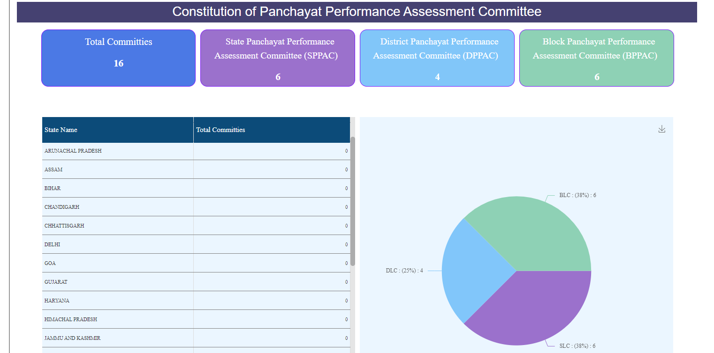
Committee (BPPAC,DPPAC,SPPAC ) Monitoring Report

Slide 38
Thank You

